Slide 1
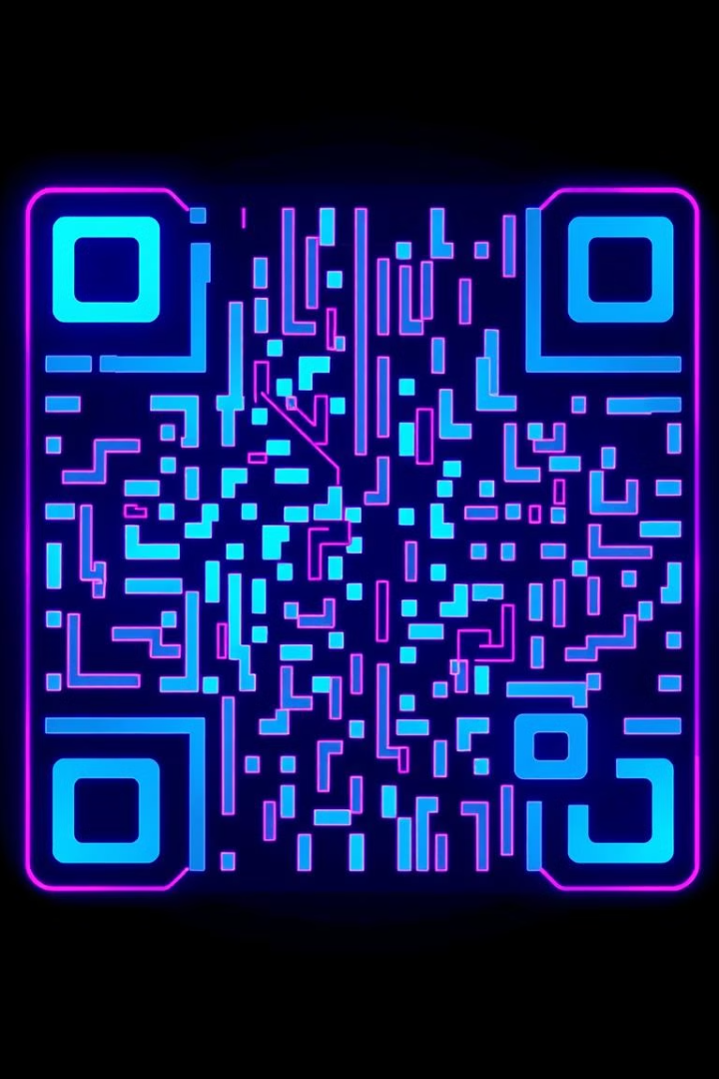
Steganography of Encrypted Messages inside Valid QR Codes
This presentation explores a novel approach to enhancing QR code security by integrating Advanced Encryption Standard (AES) encryption with steganographic techniques. By embedding encrypted data within QR codes, this method provides a robust layer of protection against unauthorized access.
By:-
Navoneel Mondal (21BCE1217)
Kaustuv Mishra (21BCE1768)
Kavish Paul (21BCE1539)

Slide 2

Problem Statement
1
Vulnerable Data
2
Breach Risk
3
Usability Challenges
Traditional QR codes lack inherent security features, leaving sensitive data vulnerable to interception and manipulation.
QR codes are widely used for transactions, login credentials, and other sensitive information, making security a critical concern.
Balancing security with usability is crucial to ensure user adoption and prevent complex procedures from hindering the convenience of QR codes.

Slide 3

Abstract
1
Encryption
Sensitive data is encrypted using AES with a user-defined key, rendering the information unreadable without the correct key.
2
Steganography
The encrypted data is then hidden within the QR code's visual structure using steganographic techniques, making it invisible to the naked eye.
3
Decoding & Decryption
Upon scanning, the hidden data is extracted and decrypted using the same key, revealing the original message while ensuring its integrity.

Slide 4

Motivation
Growing Reliance
Data Security Risk
Simple Solution
QR codes are increasingly integrated into daily life, from payments and access control to authentication and data sharing.
The widespread use of QR codes demands secure data transmission to prevent unauthorized access, manipulation, and potential data breaches.
This project provides a straightforward yet effective method to secure sensitive data embedded within QR codes, offering a practical solution to a growing security concern.

Slide 5
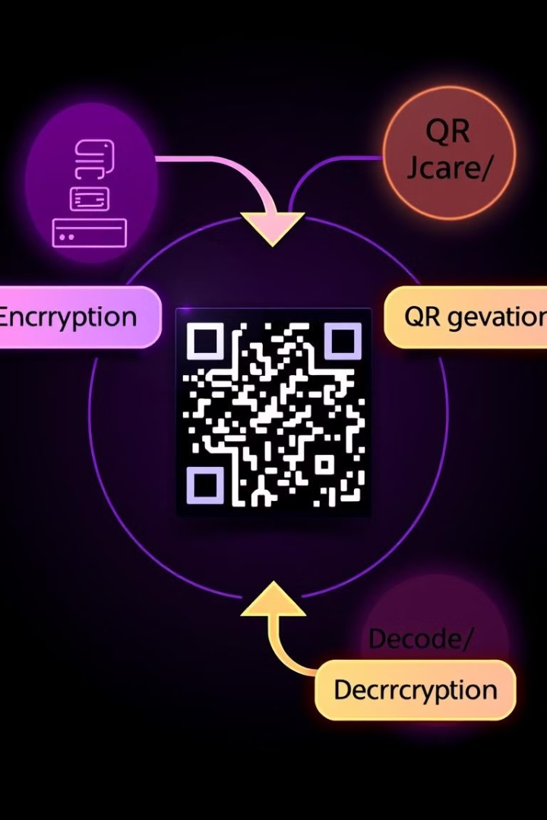



Our Approach
Encryption
Messages are encrypted using the Advanced Encryption Standard (AES) algorithm, a robust and widely used symmetric encryption method.
QR Code Generation
The encrypted data is then embedded into a QR code using steganographic techniques, effectively hiding the encrypted message within the code's visual structure.
Decoding & Decryption
The QR code is scanned to extract the hidden encrypted data, which is then decrypted using the same key used for encryption, revealing the original message.

Slide 6
Implementation
Programming Language
Encryption Module
QR Code Module
Python was chosen for its ease of use, extensive libraries, and widespread accessibility for developers.
The pycryptodome library provides efficient and secure AES encryption and decryption capabilities.
The qrcode library is used to generate QR codes, while opencv-python facilitates image processing for steganographic embedding.

Slide 7

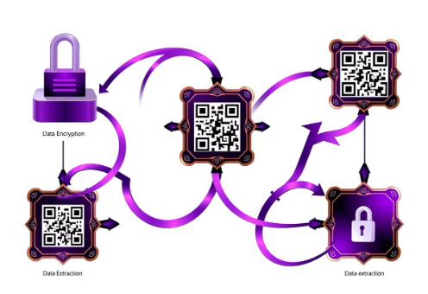
Flow Diagram
1.
User inputs a message and a secret key.
2.
The message is encrypted using AES with the provided key.
3.
The encrypted data is embedded into a QR code using steganographic techniques.
4.
The generated QR code is displayed or saved.
5.
The QR code is scanned by a receiver.
6.
The encrypted data is extracted from the QR code.
7.
The data is decrypted using the same secret key.
8.
The original message is recovered.

Slide 8





Literature Review
Steganography Techniques
QR Codes as Medium
Numerous methods exist to conceal information within various mediums, including images, videos, and QR codes, making it difficult to detect.
QR codes inherently contain redundant information, making them suitable for data embedding through steganographic techniques without significantly impacting their readability.
Encryption Integration
Challenges
Combining AES encryption with steganography provides a dual-layer security approach, ensuring both data confidentiality and hidden transmission.
Balancing data payload size, QR code readability, and robustness against noise and distortion is a crucial aspect of effective implementation.

Slide 9

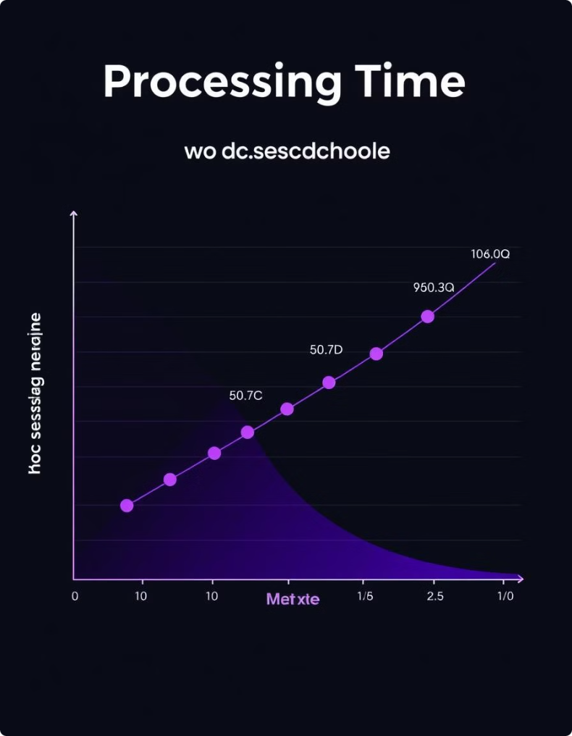
Results and Discussion
1
Encryption Performance
2
Steganographic Embedding
AES consistently encrypts messages of varying sizes efficiently, with stable and predictable processing times regardless of message length.
The implementation successfully embeds encrypted data into QR codes with varying levels of density, maintaining readability for low-density codes while accommodating larger payloads in high-density codes.
3
Stability & Error Tolerance
4
Usability
The system demonstrates resilience to common disturbances, such as scratches, blurring, and occlusion, ensuring data integrity and readability even under imperfect scanning conditions.
The current implementation provides a command-line interface (CLI) for technical users, but a graphical user interface (GUI) is recommended for wider accessibility and user-friendliness.

Slide 10

Future Improvements
Payload Optimization
GUI Development
Adaptive Techniques
Optimizing the system to handle larger encrypted messages without compromising QR code readability or requiring significant changes to the code's visual representation.
Creating a user-friendly graphical user interface (GUI) for a wider range of users, offering an intuitive and accessible experience for encoding, decoding, and managing QR codes.
Exploring adaptive techniques that dynamically adjust the embedding and decryption methods based on environmental conditions, improving resilience against noise and distortion.

